Slide 1
IOT Temperature Presentation
Looking at temperature readings over time.

Slide 2
Temperature Reading Data
I received a large amount of temperature readings from many devices over the course of 2018.
I used the readings to present some interesting facts about the temperature in the area.
This information can be used to make comparisons to other time periods or other regions.

Slide 3
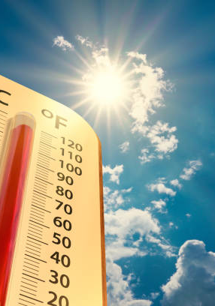
Area Temperature Ask yourself:
What can this tell us?
How can we use this information?
Who would find the temperature information valuable?
Why is this relevant to my business?
I will answer the first three questions and leave the fourth as an interactive engagement for YOU to answer!

Slide 4
You asked questions? I have answers!
Questions
Answers
What can this tell us?
How can we use this information?
Who would find the temperature information valuable?
The dataset I analyzed can tell us the warmest/ coldest temperatures of 2018 as well as the average temperatures.
This information can be used to schedule events in safe temperature ranges based on predictions as well as comparison across time periods for the region just to name a few.
This information is valuable to any organization that relies upon outdoor or unconditioned environmental factors for scheduling or profit purposes.

Slide 5
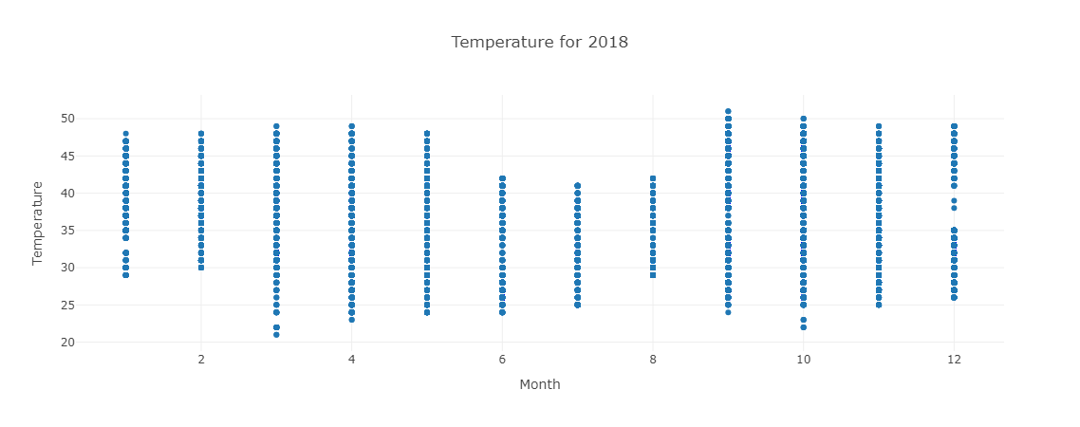
Graph of Temperature Readings per Month

Slide 6
Looking Forward
This graph is plotted points for all the readings across 2018 by Month.
The Temperature is in Celsius and tells us a few things immediately.
The hottest reading was in the month of September.
The coldest reading was in the month of March.
The bulk of the temperature in this region is between 25 degrees and 45 degrees at just a quick glance.
The biggest swing is in the month of February.
The temperature varies quite often in each month with June-August being more stable.

Slide 7
Temperature In Conclusion
This small presentation gave us a solid amount of information about temperatures over the course of 2018 in your region.
The high of 51 in September and low of 21 in March are two times of the year for instability in unconditioned spaces that can be accounted for in planning and scheduling.
The middle of the year June-August are possibly great scheduling months for outdoor events with the stability of temperatures.
The next step is to compare these findings with alternate years for the region.
Remember to ask yourself, “Why is this relevant to my business?”
Have a Great Day!

